Slide 1
Image Processing Project
Nikhil 21BEC1448
M Ravishankar 21BEC1585

Slide 2
Introduction
Digital Image Processing means processing digital image by means of a digital computer. We can also say that it is a use of computer algorithms, in order to get enhanced image either to extract some useful information.
Digital image processing is the use of algorithms and mathematical models to process and analyze digital images.

Slide 3
Goal of image processing
The goal of digital image processing is to enhance the quality of images, extract meaningful information from images, and automate image-based tasks Image processing mainly include the following steps: 1.Importing the image via image acquisition tools; 2.Analysing and manipulating the image; 3.Output in which result can be altered image or a report which is based on analysing that image

Slide 4
Types of images
BINARY IMAGE– The binary image as its name suggests, contain only two pixel elements i.e 0 & 1,where 0 refers to black and 1 refers to white. This image is also known as Monochrome.
BLACK AND WHITE IMAGE– The image which consist of only black and white color is called BLACK AND WHITE IMAGE.
8 bit COLOR FORMAT– It is the most famous image format.It has 256 different shades of colors in it and commonly known as Grayscale Image. In this format, 0 stands for Black, and 255 stands for white, and 127 stands for gray.
16 bit COLOR FORMAT– It is a color image format. It has 65,536 different colors in it.It is also known as High Color Format. In this format the distribution of color is not as same as Grayscale image.

Slide 5
Viola jones algorithm
The Viola-Jones algorithm first detects the face on the grayscale image and then finds the location on the colored image. Viola-Jones outlines a box and searches for a face within the box. It is essentially searching for these haar-like features, which will be explained later.
Viola-Jones algorithm uses AdaBoost to find the best features and to train a classifier. Each Haar-like feature represents a weak classifier. The final classifier is given by a linear combination of weak classifiers. Larger weights are associated with better classifiers using the AdaBoost learning algorithm

Slide 6
Uses of viola –jones algorithm to detect the following:
Real time Face Emotion Recognition Using Matlab
Human Action recognition using Image Processing
Breast Cancer Detection using Neural Networks
Handwritten recognition using advanced algorithmic processing
Object detection
Pedestrian detection
Lane detection for ADAS
Blind assistance systems
Gesture recognition
Drowsy driver detection

Slide 7
Image processing advantages
Image processing has a wide range of applications in various fields, including medical imaging, surveillance, remote sensing, robotics, computer vision, and entertainment. It plays a crucial role in improving image quality, extracting valuable information, and enabling automated analysis and decision-making based on visual data
Advantages of Digital Image Processing: Improved image quality: Digital image processing algorithms can improve the visual quality of images, making them clearer, sharper, and more informative. Automated image-based tasks: Digital image processing can automate many image-based tasks, such as object recognition, pattern detection, and measurement. Increased efficiency: Digital image processing algorithms can process images much faster than humans, making it possible to analyze large amounts of data in a short amount of time. Increased accuracy: Digital image processing algorithms can provide more accurate results than humans, especially for tasks that require precise measurements or quantitative analysis.

Slide 8
Basic code for our project : for image face detection
faceDetector = vision.CascadeObjectDetector;
I = imread('https://encrypted-tbn0.gstatic.com/images?q=tbn:ANd9GcSiaF-
_AXa0jvi_wAzgzLBrLKt-BOvyy4yP_rrGapG-Pw&s');
bboxes = faceDetector(I);
IFaces = insertObjectAnnotation(I,'rectangle',bboxes,'Face');
figure
imshow(IFaces)
title('Detected faces');

Slide 9
MATLAB CODE FOR UPPER BODY DETECTION USING Viola jones ALGORITHM
bodyDetector = vision.CascadeObjectDetector('UpperBody');
bodyDetector.MinSize = [60 60];
bodyDetector.MergeThreshold = 10;
I2 = imread('https://media.istockphoto.com/id/1350474131/photo/business-team-portrait.jpg?s=612x612&w=0&k=20&c=_rwVn8lkmzXc-_Q5tSyH-Jt0tt_acwxvXVYCckg8v0M=');
bboxBody = bodyDetector(I2);
IBody = insertObjectAnnotation(I2,'rectangle',bboxBody,'Upper Body');
figure
imshow(IBody)
title('Detected upper bodies');

Slide 10
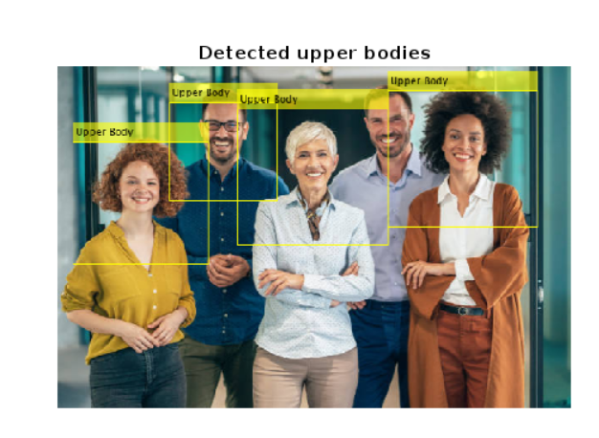
Output:

Slide 11
MATLAB CODE FOR FACE DETECTION USING Viola jones ALGORITHM
faceDetector=vision.CascadeObjectDetector('FrontalFaceCART'); %Create a detector object
img=imread('1.jpg'); %Read input image
img=rgb2gray(img); % convert to gray
BB=step(faceDetector,img); % Detect faces
iimg = insertObjectAnnotation(img, 'rectangle', BB, 'Face'); %Annotate detected faces.
figure(1);
imshow(iimg);
title('Detected face');
htextinsface = vision.TextInserter('Text', 'face : %2d', 'Location', [5 2],'Font', 'Courier New','FontSize', 14);
%imshow(img);
hold on
for i=1:size(BB,1)
rectangle('position',BB(i,:),'Linewidth',2,'Linestyle','-','Edgecolor','y');
end
hold on
N=size(BB,1);
handles.N=N;
counter=1;
for i=1:N
face=imcrop(img,BB(i,:));

Slide 12
savenam = strcat('D:\Detect face\' ,num2str(counter), '.jpg'); %this is where and what your image will be saved
baseDir = 'D:\Detect face\TestDatabase\';
% baseName = 'image_';
newName = [baseDir num2str(counter) '.jpg'];
handles.face=face;
while exist(newName,'file')
counter = counter + 1;
newName = [baseDir num2str(counter) '.jpg'];
end
fac=imresize(face,[112,92]);
imwrite(fac,newName);
figure(2);
imshow(face);
title('crop pic');
pause(.5);
end

Slide 13
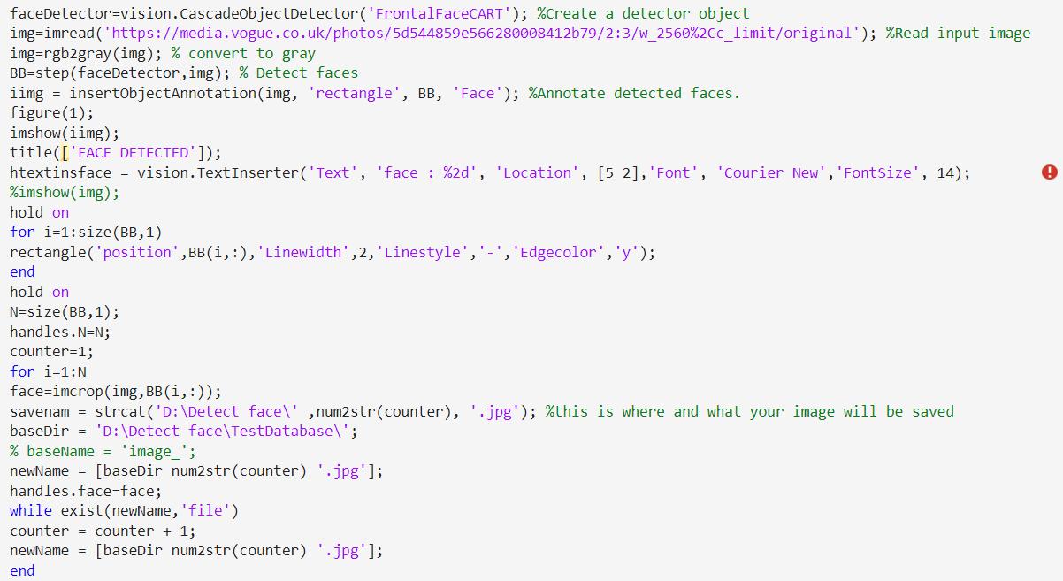
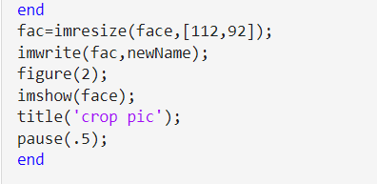

Slide 14
